Slide 1
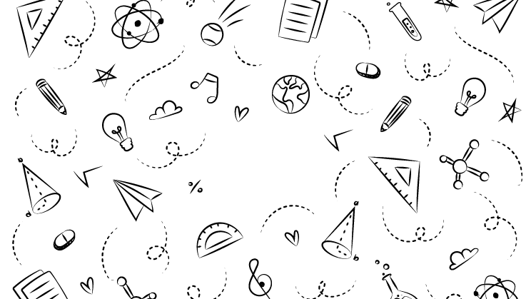



NEXT GEN EMPLOYABILITY PROGRAM
Creating a future-ready workforce
Team Members
Student Name :Vishnu A
Student ID :110321104058
Nm Id:au110321104058
Email:achuachuachu619@gmail.com
College Name
1103-GRT Institute of Engineering and Technology

Slide 2

CAPSTONE PROJECT SHOWCASE
Project Title
MUSIC WEB APPLICATION USING DJANGO FRAMEWORK
Abstract | Problem Statement | Project Overview | Proposed Solution | Technology Used | Modelling & Results | Conclusion

Slide 3
Abstract
1. User Account Creation and Login:
Users create accounts and log in.
Upon successful login, they are redirected to the home page.
2. Song Search and Playback:
Users can search for songs based on their preferences.
An API fetches songs and displays them on the home page.
Users can easily play the songs.
3. Admin Panel for Management:
The admin panel allows managing the login system.
Custom user models extend the default Django user model.
Authentication and authorization are handled effectively.
4. Song Metadata and Images:
The application stores song metadata (title, category, artist) and audio files.
Corresponding images related to songs are displayed on the home page.

Slide 4
Problem Statement
1. User-Friendly Music Playback:
Design an application that allows users to create accounts and log in.
Upon successful login, users should be redirected to the home page.
Implement a search feature for songs based on user preferences.
Enable smooth playback of songs using an API.
2. Admin Panel and User Management:
Develop an admin panel for managing user accounts.
Extend the default Django user model to include custom fields.
Handle authentication and authorization effectively.
3. Song Metadata and Images:
Store essential song details (title, category, artist) in the database.
Associate audio files with songs.
Display corresponding images related to each song on the home
Source :

Slide 5
Project Overview
1. User Account Creation and Login:
Users can create accounts and log in.
After successful login, they are redirected to the home page.
2. Song Search and Playback:
Users can search for songs based on their preferences.
An API fetches songs and displays them on the home page.
Users can easily play the songs.
3. Admin Panel for Management:
The admin panel allows managing the login system.
Custom user models extend the default Django user model.
Authentication and authorization are handled effectively.
4. Song Metadata and Images:
The application stores song metadata (title, category, artist) and audio files.
Corresponding images related to songs are displayed on the home page.

Slide 6
Proposed Solution
.
Project Setup and Configuration:
Create a Django Project: Begin by setting up a new Django project using the django-admin startproject command. This will create the project folder structure.
App Creation: Within the project, create two Django apps: one for managing user accounts and authentication (e.g., accounts), and another for handling music-related functionality (e.g., music_player).
Configure Settings: Update the INSTALLED_APPS in the project’s settings.py to include your custom apps and any necessary third-party packages (e.g., rest_framework).
2. Database Models and Relationships:
Song Model: Define a Django model named Song in the music_player app. This model should include fields for song metadata, such as title, category, artist, audio file (uploaded using FileField), and an associated audio image (also uploaded using FileField).
Custom User Model: Extend the default Django user model by creating a custom user model (e.g., CustomUser) in the accounts app. This allows you to add additional fields specific to your application (e.g., profile picture, favorite genres).
Source :

Slide 7
Proposed Solution
3. Views and API Endpoints:
Song Views: Create views for listing songs, adding new songs, updating existing songs, and deleting songs. Use Django Rest Framework (DRF) to create API endpoints (e.g., SongListCreateView, SongDetailView) that interact with the Song model.
User Views: Implement views for user registration, login, and authenticated user actions (e.g., viewing the home page, adding a song). Use Django forms for registration and login, and ensure that certain actions require user authentication.
4. Frontend and Templates:
Home Page: Design a clean and user-friendly home page where users can search for songs, view song listings, and play songs. Display song details along with corresponding images.
User Authentication: Create login and registration forms. After successful login, redirect users to the home page.
Responsive Design: Ensure that the application works well on different devices (desktop, tablet, mobile).

Slide 8


Technology Used
Front-end
Back-end
Source :

Slide 9
Modelling & Results
1. Modeling and Database Setup:
Song Model: Define a Django model named “Song” with fields for song metadata (title, category, artist), audio file, and audio image. This model represents individual songs in the application.
Custom User Model: Extend the default Django user model to include additional fields (e.g., profile picture, favorite genres) for user customization.
2. Views and API Endpoints:
Song Views: Create Django Rest Framework views for listing songs (SongListCreateView) and handling individual song details (SongDetailView). These views interact with the “Song” model.
User Views: Implement views for user registration, login, and authenticated actions (e.g., adding songs). Ensure proper authentication and authorization.
3. Frontend and Templates:
Home Page: Design a user-friendly home page where users can search for songs, view song listings, and play songs. Display song details and corresponding images.
User Authentication: Create login and registration forms. After successful login, redirect users to the home page.

Slide 10
Homepage

Slide 12
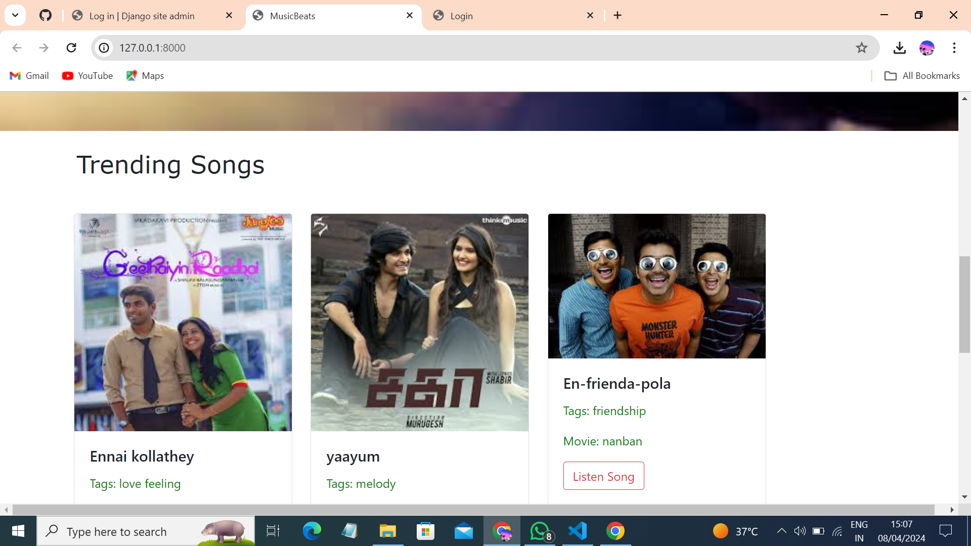

Slide 13
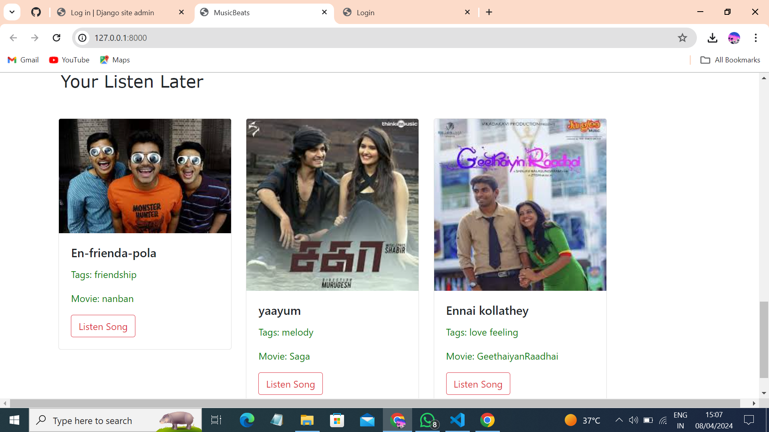
Listen later

Slide 14
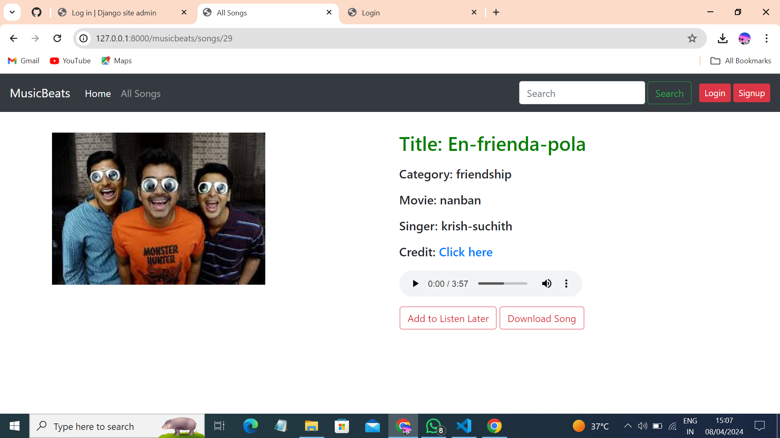
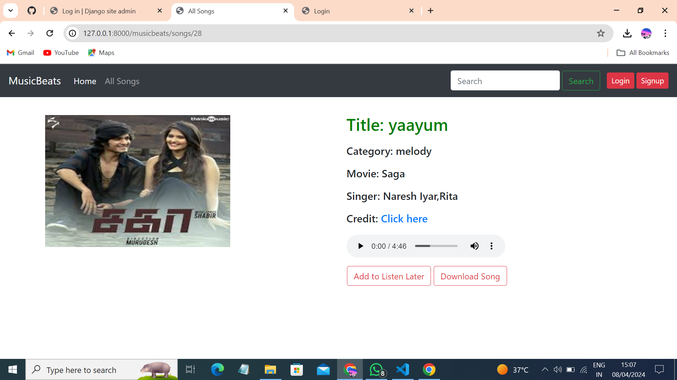
Blog-Page

Slide 15
Future Enhancements:
User Profiles and Playlists:
Implement user profiles where users can create and manage their playlists.
Allow users to customize their profiles with avatars, bios, and favorite genres.
Enhance the playlist functionality by enabling collaborative playlists and sharing options.
2. Advanced Search and Recommendations:
Enhance the search functionality to support filters like artist, genre, album, and release year.
Implement recommendation algorithms based on user preferences, listening history, and similar artists.
Provide personalized song recommendations to users based on their activity.
3. Social Integration and Sharing:
Integrate social media platforms to allow users to share their favorite songs and playlists.
Enable users to follow other users, discover new music, and see what their friends are listening to.
Implement social features like comments, likes, and user-generated playlists.
4. Audio Visualization and Lyrics Display:
Add visualizers that respond to the music’s beat and rhythm, enhancing the user experience.
Display lyrics synchronized with the currently playing song.

Slide 16
Conclusion
1. Empowering Music Lovers:
A Django-based music app provides a platform for music enthusiasts to explore, discover, and enjoy their favorite tunes.
By seamlessly integrating features like user profiles, playlists, and recommendations, it caters to diverse musical tastes.
2. Social Interaction and Sharing:
Leveraging social integration, the app fosters a sense of community among users.
Sharing playlists, commenting on tracks, and following other music lovers enhance the overall experience.
3. Enhanced User Experience:
Features like advanced search, synchronized lyrics, and audio visualizers elevate the app’s usability.
Personalized recommendations keep users engaged and excited about their musical journey.
4. Continuous Improvement:
Regular updates, bug fixes, and performance enhancements ensure a smooth and delightful music experience.
The journey doesn’t end—keep refining and expanding the app to keep users coming back for more! 🎵🎧

Slide 17
Thank You!
Notes:
Thank You !!

